Slide 1

Lecture 3:
CMOS Transistor Theory

Slide 2
Outline
Introduction
MOS Capacitor
nMOS I-V Characteristics
pMOS I-V Characteristics
Gate and Diffusion Capacitance
3: CMOS Transistor Theory

Slide 3
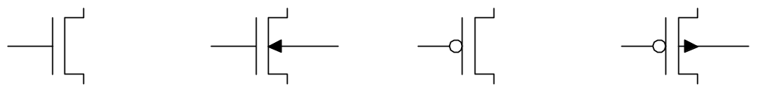
Introduction
So far, we have treated transistors as ideal switches
An ON transistor passes a finite amount of current
  Depends on terminal voltages
  Derive current-voltage (I-V) relationships
Transistor gate, source, drain all have capacitance
  I = C (ΔV/Δt) -> Δt = (C/I) ΔV
  Capacitance and current determine speed
3: CMOS Transistor Theory
Notes:
Chung minh
Q = CU = CV
I = d(Q)/d(t) ~ delta(Q)/delta(t)
C là hang so
I = C(dv)/d(t)

Slide 4
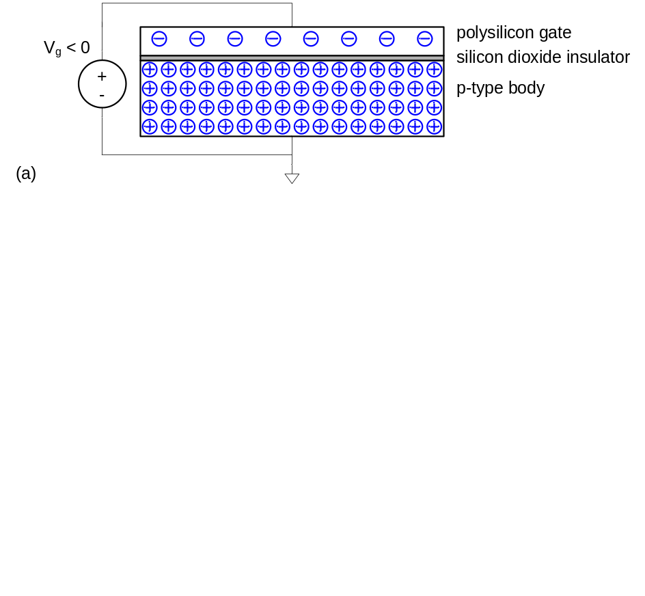
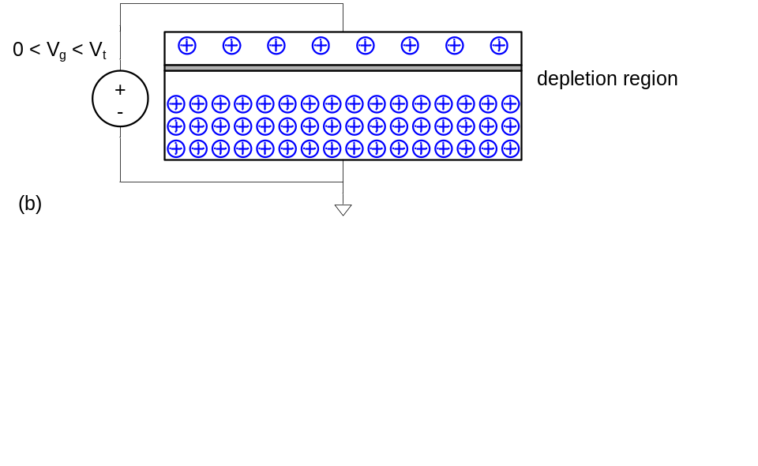
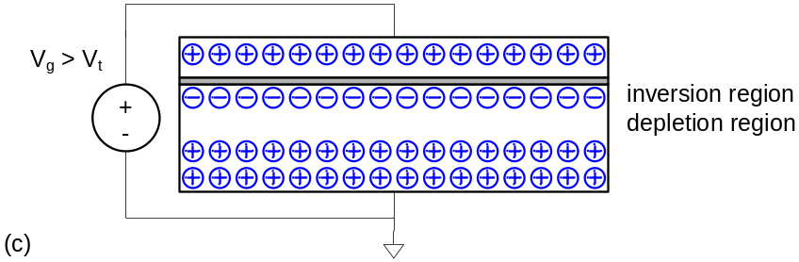
MOS Capacitor
Gate and body form MOS capacitor
Operating modes
  Accumulation
  Depletion
  Inversion
3: CMOS Transistor Theory
Notes:
Vùng tích lúy
Cạn kiện
Đảo ngược

Slide 5
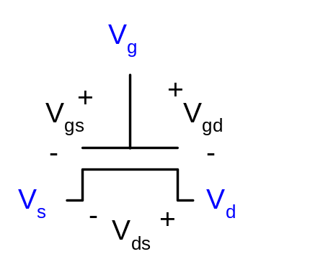
Terminal Voltages
Mode of operation depends on V_{g}, V_{d}, V_{s}
  V_{gs} = V_{g} – V_{s}
  V_{gd} = V_{g} – V_{d}
  V_{ds} = V_{d} – V_{s} = V_{gs} - V_{gd}
Source and drain are symmetric diffusion terminals
  By convention, source is terminal at lower voltage
  Hence V_{ds} ≥ 0
nMOS body is grounded. First assume source is 0 too.
Three regions of operation
  Cutoff
  Linear
  Saturation
3: CMOS Transistor Theory

Slide 6
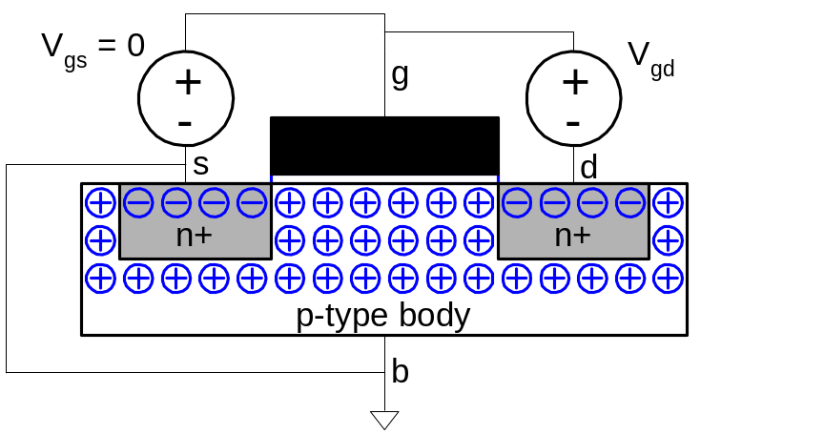
nMOS Cutoff
No channel
I_{ds} ≈ 0
3: CMOS Transistor Theory

Slide 7
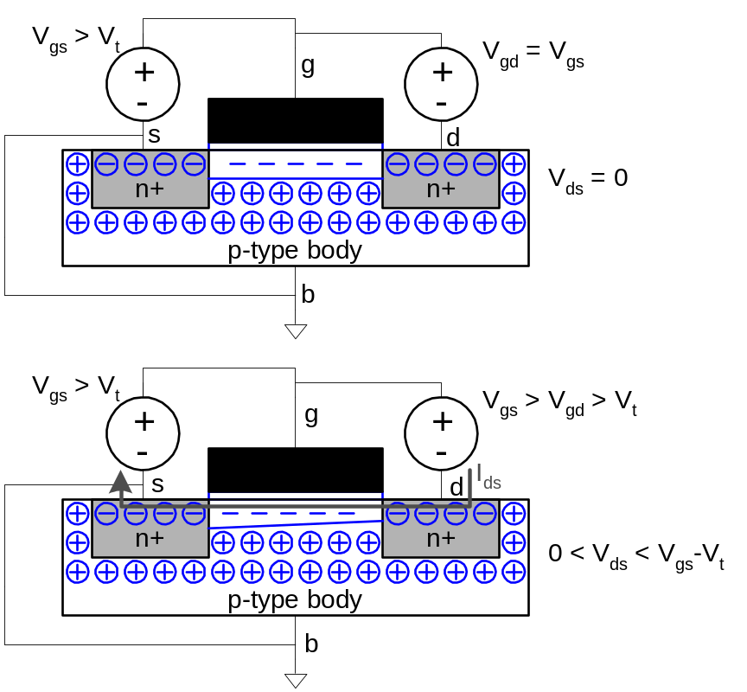
nMOS Linear
Channel forms
Current flows from d to s
  e⁻ from s to d
I_{ds} increases with V_{ds}
Similar to linear resistor
3: CMOS Transistor Theory

Slide 8
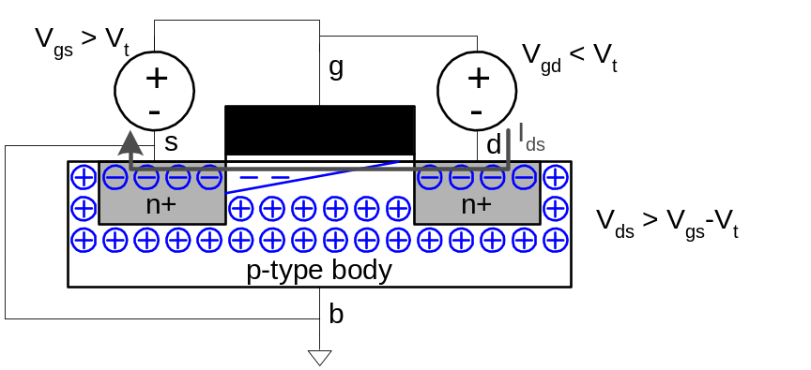
nMOS Saturation
Channel pinches off
I_{ds} independent of V_{ds}
We say current saturates
Similar to current source
3: CMOS Transistor Theory

Slide 9
I-V Characteristics
In Linear region, I_{ds} depends on
  How much charge is in the channel?
  How fast is the charge moving?
3: CMOS Transistor Theory

Slide 10
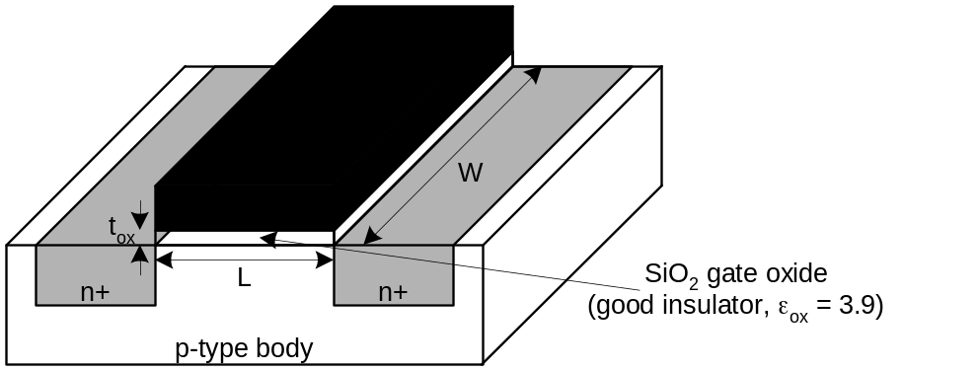
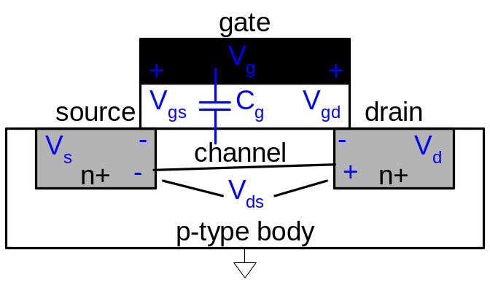
Channel Charge
MOS structure looks like parallel plate capacitor while operating in inversions
  Gate – oxide – channel
Q_{channel} = CV
C = C_{g} = ε_{ox}WL/t_{ox} = C_{ox}WL
V = V_{gc} – V_{t} = (V_{gs} – V_{ds}/2) – V_{t}
C_{ox} = ε_{ox} / t_{ox}
3: CMOS Transistor Theory

Slide 11
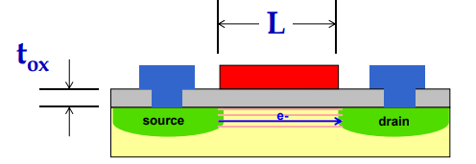
Carrier velocity
Charge is carried by e-
Electrons are propelled by the lateral electric field between source and drain
  E = V_{ds}/L
Carrier velocity v proportional to lateral E-field
  v = μE μ called mobility
Time for carrier to cross channel:
  t = L / v
3: CMOS Transistor Theory

Slide 12
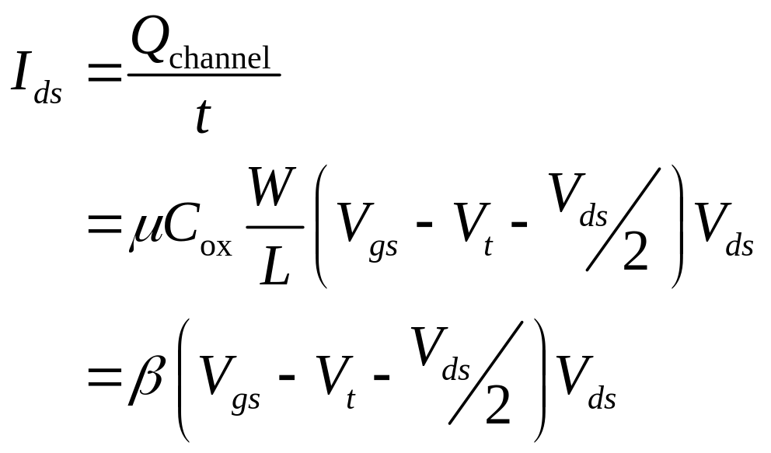
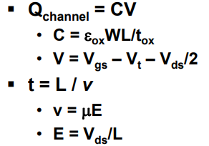
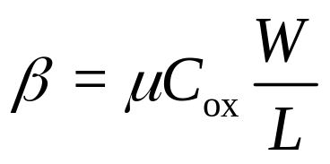
nMOS Linear I-V
Now we know
  How much charge Q_{channel} is in the channel
  How much time t each carrier takes to cross
3: CMOS Transistor Theory

Slide 13
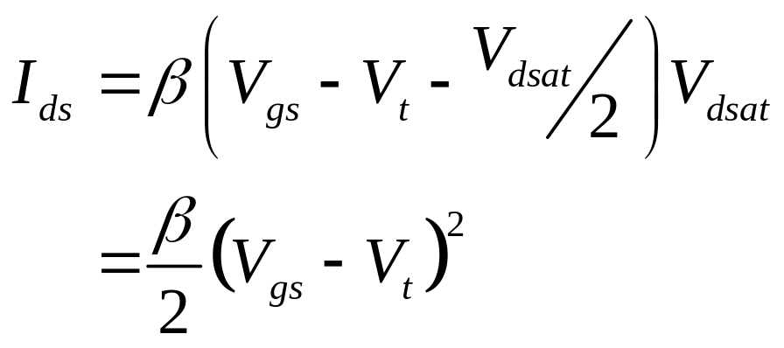
nMOS Saturation I-V
If V_{gd} < V_{t}, channel pinches off near drain
  When V_{ds} > V_{dsat} = V_{gs} – V_{t}
Now drain voltage no longer increases current
3: CMOS Transistor Theory

Slide 14
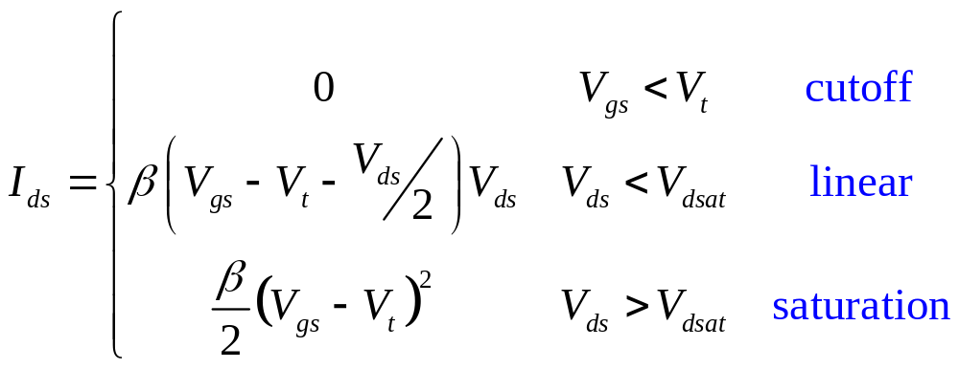
nMOS I-V Summary
Shockley 1st order transistor models
3: CMOS Transistor Theory

Slide 15
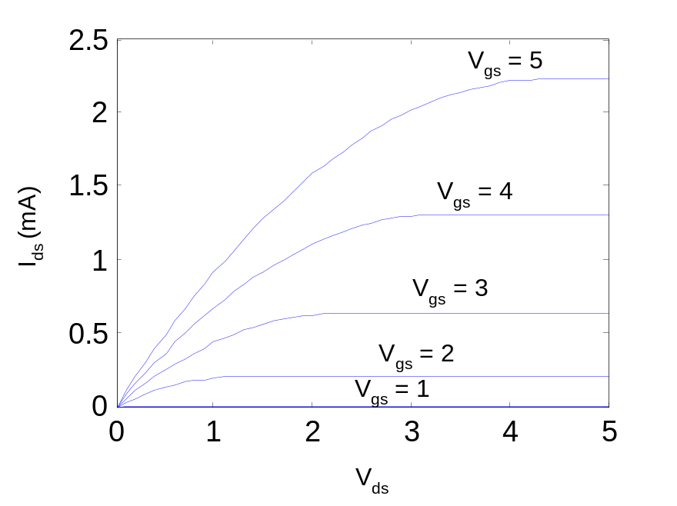
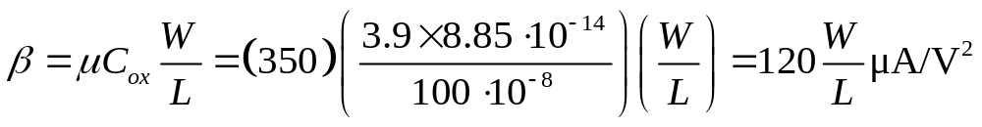
Example
We will be using a 0.6 μm process for your project
  From AMI Semiconductor
  t_{ox} = 100 Å
  μ = 350 cm²/V*s
  V_{t} = 0.7 V
Plot I_{ds} vs. V_{ds}
  V_{gs} = 0, 1, 2, 3, 4, 5
  Use W/L = 4/2 λ
3: CMOS Transistor Theory

Slide 16
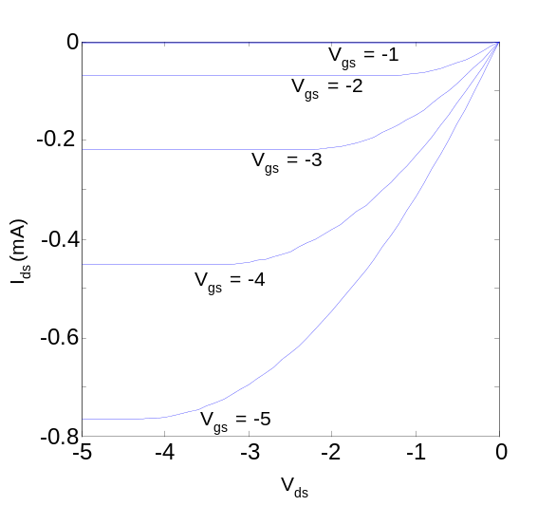
pMOS I-V
All dopings and voltages are inverted for pMOS
  Source is the more positive terminal
Mobility μ_{p} is determined by holes
  Typically 2-3x lower than that of electrons μ_{n}
  120 cm²/V•s in AMI 0.6 μm process
Thus pMOS must be wider to
provide same current
  In this class, assume
  μ_{n} / μ_{p} = 2
3: CMOS Transistor Theory

Slide 17
Capacitance
Any two conductors separated by an insulator have capacitance
Gate to channel capacitor is very important
  Creates channel charge necessary for operation
Source and drain have capacitance to body
  Across reverse-biased diodes
  Called diffusion capacitance because it is associated with source/drain diffusion
3: CMOS Transistor Theory

Slide 18

Gate Capacitance
Approximate channel as connected to source
C_{gs} = ε_{ox}WL/t_{ox} = C_{ox}WL = C_{permicron}W
C_{permicron} is typically about 2 fF/μm
3: CMOS Transistor Theory

Slide 19
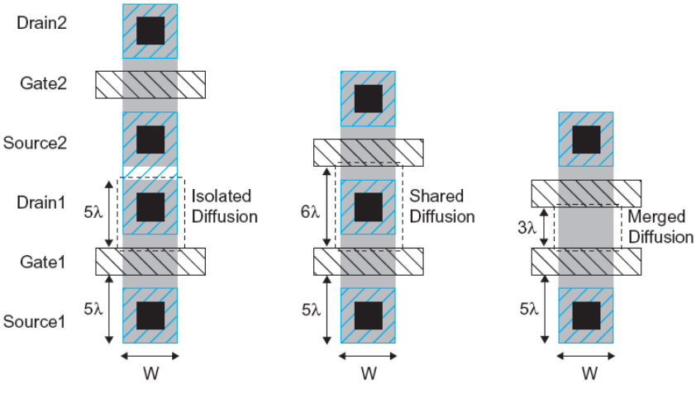
Diffusion Capacitance
C_{sb}, C_{db}
Undesirable, called parasitic capacitance
Capacitance depends on area and perimeter
  Use small diffusion nodes
  Comparable to C_{g}
  for contacted diff
  ½ C_{g} for uncontacted
  Varies with process
3: CMOS Transistor Theory

